Slide 1
Lecture-3
Scan Conversion
Line Draw Algorithm(DDA, Bresenham’s) ,
Circle, Ellipse Draw Algorithm

Slide 2
Rasterization
Final step in pipeline: rasterization (scan conv.)
From screen coordinates (float) to pixels (int)
Writing pixels into frame buffer
Separate z-buffer, display, shading, blending
Concentrate on primitives:
  Lines
  Polygons
Uses Incremental Function Evaluation
  f(x_{i+1}) = f(x_{i}) + Δf_{xi}
  Fast but cumulative Error
  Need to find f(x₀)

Slide 3
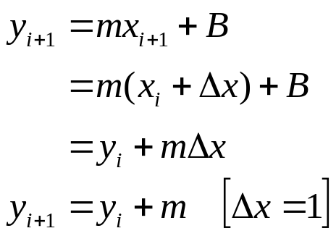
DDA Algorithm
DDA (“Digital Differential Analyzer”)
Assume 0 ≤ m ≤ 1 else flip about y= x line.
(x_{i},Round(y_{i}+m))
Desired Line
(x_{i},y_{i})
(x_{i},Round(y_{i}))
(x_{i},y_{i} +m)
void Line(int x0, int y0, int x1, int y1, int value) {
double y = y0;
double m = (y1 – y0) / (x1 – x0); // 0 <= m <= 1
for (int x = x0; x <= x1; x++) {
WritePixel(x, Round(y), value);
y += m;
}
}
Require to eliminate floating point operations & variables

Slide 4
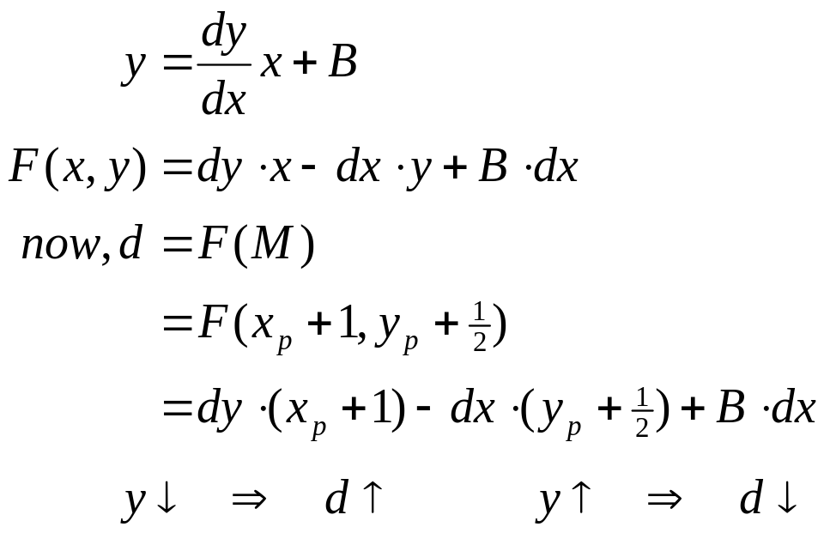
Midpoint Line Algorithm
Assume
  0 ≤ m ≤ 1 [ else flip about y= x line. ]
  (x₀, y₀) and (x₁, y₁) are integer values
At each iteration we determine if the line intersects the next pixel above or below its midpoint y value.
  if above then NE ⇒ y_{new} = y_{p}+1
  otherwise E ⇒ y_{new} = y_{p}
d=F(M) > 0 ⇒ NE
NE
M
y_{p}+1
P=(x_{p}, y_{p})
E
y_{p}
x_{p}
x_{p}+1
d=F(M) < 0 ⇒ E
NE
y_{p}+1
M
P=(x_{p}, y_{p})
E
y_{p}
x_{p}
x_{p}+1

Slide 5
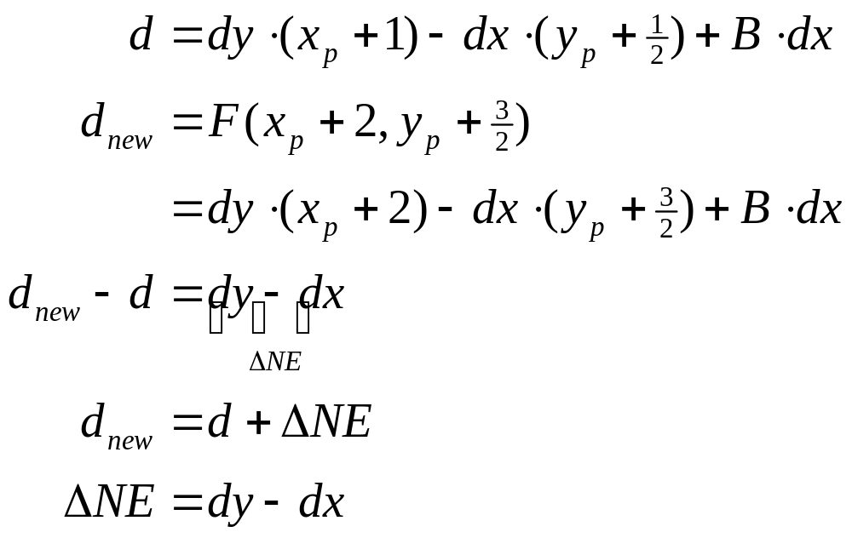


Midpoint Line Algorithm
P=(x_{p}, y_{p}) is pixel chosen by the algorithm in previous step
To calculate d incrementally we require d_{new}
If d > 0 then choose NE
Y_{p}+2
M_{NE}
NE
M
Y_{p}+1
E
y_{p}
P=(x_{p}, y_{p})
x_{p}
x_{p}+1
x_{p}+2
Previous
Current
Next

Slide 6
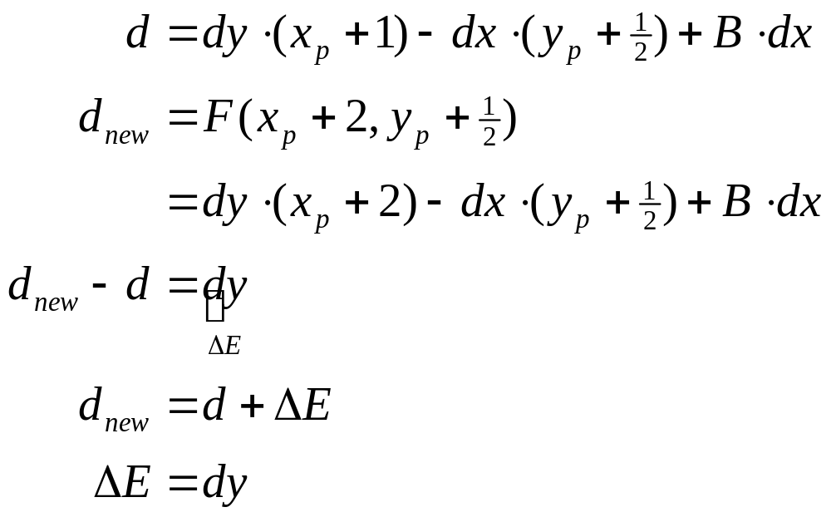


Midpoint Line Algorithm
If d < 0 then choose E
Y_{p}+2
NE
Y_{p}+1
M
M_{E}
E
y_{p}
P=(x_{p}, y_{p})
x_{p}
x_{p}+1
x_{p}+2
Previous
Current
Next

Slide 7
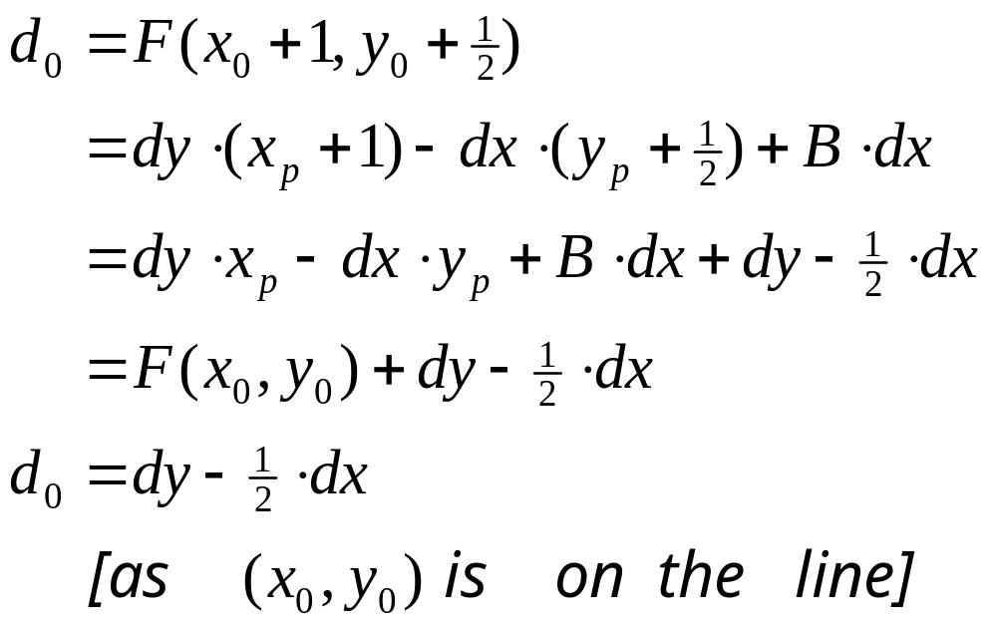

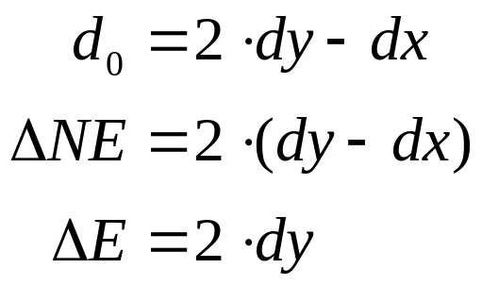
Midpoint Line Algorithm
To find Initial value of d
NE
M
P=(x₀, y₀)
E
x₀
x₀+1
Only fractional value
Start
Initial d_{o}
Multiply by 2 to avoid fractions. Redefine d₀, ΔE, ΔNE

Slide 8




Midpoint Line Algorithm
void MidpointLine(int x0, int y0, int x1, int y1, int color)
{
int dx = x1 – x0, dy = y1 – y0;
int d = 2*dy – dx;
int dE = 2*dy, dNE = 2*(dy – dx);
int x = x0, y = y0;
WritePixel(x, y, color);
while (x < x1) {
if (d <= 0) { // Current d
d += dE; // Next d at E
x++;
} else {
d += dNE; // Next d at NE
x++;
y++
}
WritePixel(x, y, color);
}
}
NE
(x_{i},y_{i})
M
P=(x_{p}, y_{p})
E
x_{p}
x_{p}+1
x_{p}+2
Previous
Current
Next
NE
(x_{i},y_{i})
M
P=(x_{p}, y_{p})
E
x_{p}
x_{p}+1
x_{p}+2
Previous
Current
Next

Slide 9
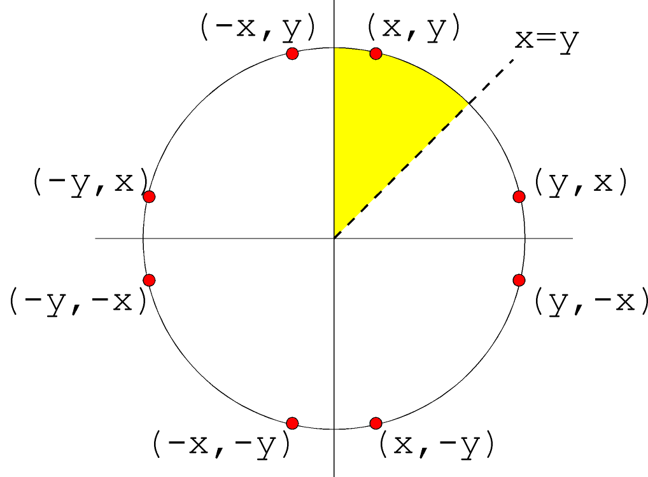
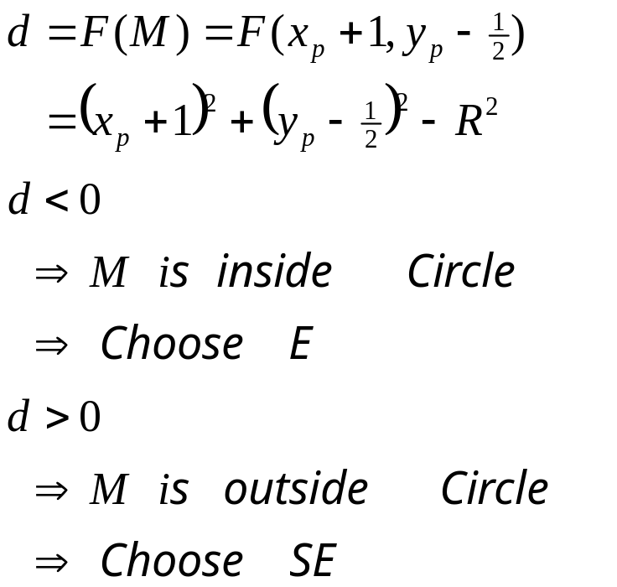


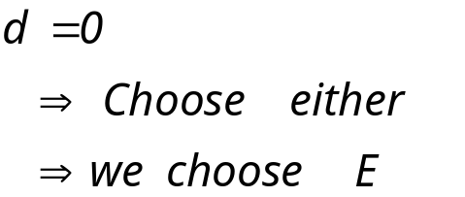
Midpoint Circle Algorithm
Implicit of equation of circle is:
  x² + y² - R² = 0
Eight way symmetry ⇒ require to calculate one octant
Define decision variable d as:
P=(x_{p}, y_{p})
E
y_{p}
M
M_{E}
y_{p} – 1
SE
M_{SE}
y_{p} – 2
x_{p}
x_{p}+1
x_{p}+2
Previous
Current
Next

Slide 10
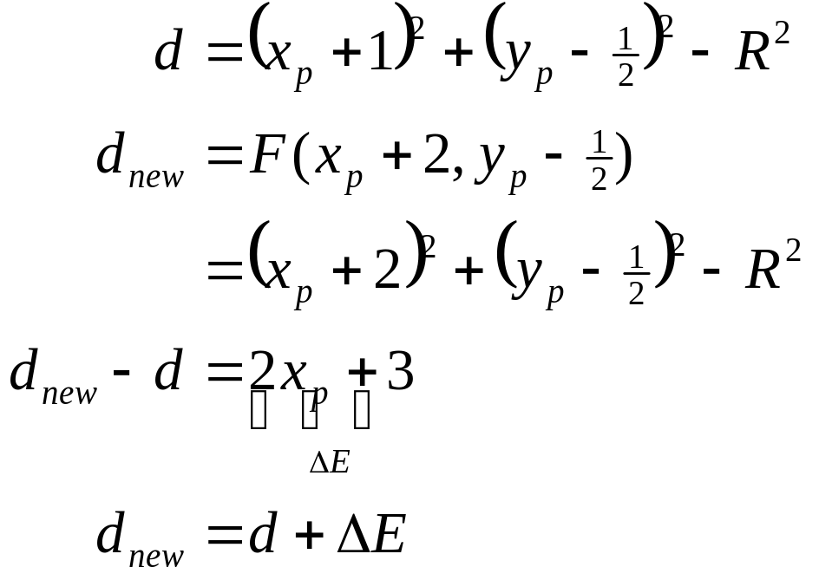
Midpoint Circle Algorithm
If d <= 0 then midpoint m is inside circle
  we choose E
  Increment x
  y remains unchanged
P=(x_{p}, y_{p})
E
y_{p}
d < 0
M
M_{E}
y_{p} – 1
y_{p} – 2
x_{p}
x_{p}+1
x_{p}+2
Previous
Current
Next

Slide 11

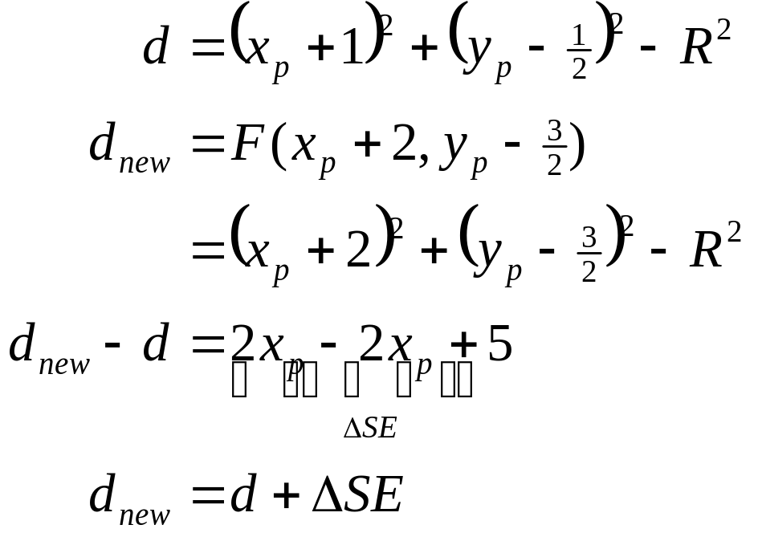
Midpoint Circle Algorithm
If d > 0 then midpoint m is outside circle
  we choose E
  Increment x
  Decrement y
P=(x_{p}, y_{p})
y_{p}
d > 0
M
y_{p} – 1
SE
M_{SE}
y_{p} – 2
x_{p}
x_{p}+1
x_{p}+2
Previous
Current
Next

Slide 12
Midpoint Circle Algorithm
Initial condition
Starting pixel (0, R)
Next Midpoint lies at (1, R – ½)
d₀ = F(1, R – ½) = 1 + (R² – R + ¼) – R² = ⁵/₄ – R
To remove the fractional value ⁵/₄ :
  Consider a new decision variable h as, h = d – ¼
  Substituting d for h + ¼,
    d₀=⁵/₄ – R ⇒ h = 1 – R
    d < 0 ⇒ h < – ¼ ⇒ h < 0
    Since h starts out with an integer value and is incremented by integer value (ΔE or ΔSE), e can change the comparison to just h < 0

Slide 13
Midpoint Circle Algorithm
void MidpointCircle(int radius, int value) {
int x = 0;
int y = radius ;
int d = 1 – radius ;
CirclePoints(x, y, value);
while (y > x) {
if (d < 0) { /* Select E */
d += 2 * x + 3;
} else { /* Select SE */
d += 2 * ( x – y ) + 5;
y – –;
}
x++;
CirclePoints(x, y, value);
}
}

Slide 14
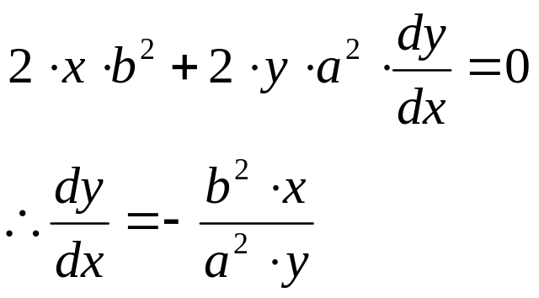
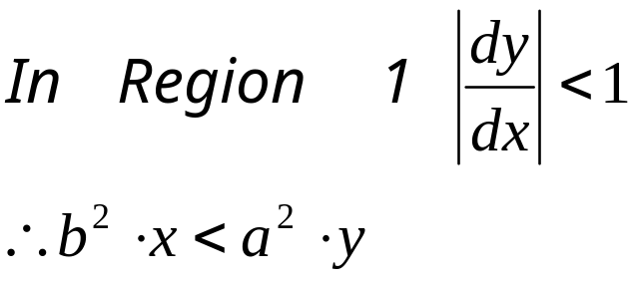
Midpoint Ellipse Algorithm
Implicit equation is: F(x,y) = b²x² + a²y² – a²b² = 0
We have only 4-way symmetry
There exists two regions
  In Region 1 dx > dy
    Increase x at each step
    y may decrease
  In Region 2 dx < dy
    Decrease y at each step
    x may increase
At region boundary:
(-x₁,y₁)
(x₁,y₁)
(-x₂,y₂)
(x₂,y₂)
(-x₂,-y₂)
(x₂,-y₂)
(-x₁,-y₁)
(x₁,-y₁)
^{E}
Tangent
Slope = -1
Gradient
Vector
^{SE}
Region 1
Region 2
^{S}
^{SE}

Slide 15
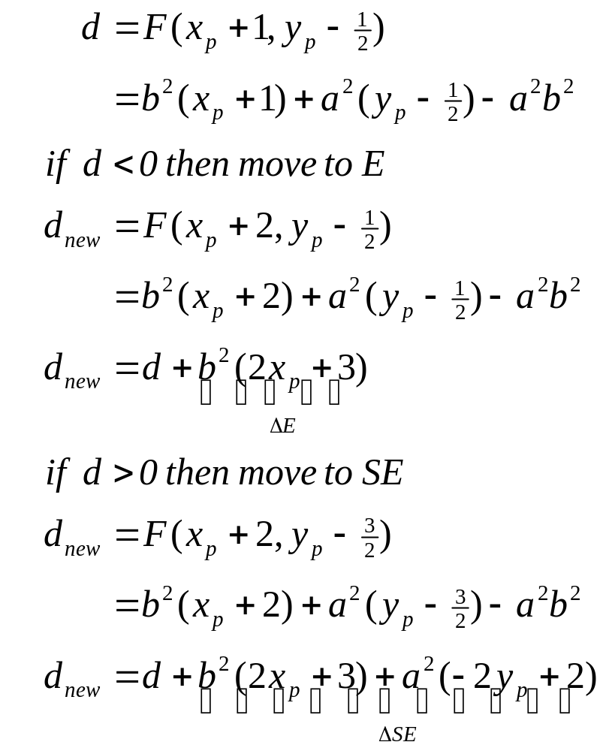

Midpoint Ellipse Algorithm
In region 1
P=(x_{p}, y_{p})
E
y_{p}
M
M_{E}
y_{p} – 1
SE
M_{SE}
y_{p} – 2
x_{p}
x_{p}+1
x_{p}+2
Previous
Current
Next

Slide 16
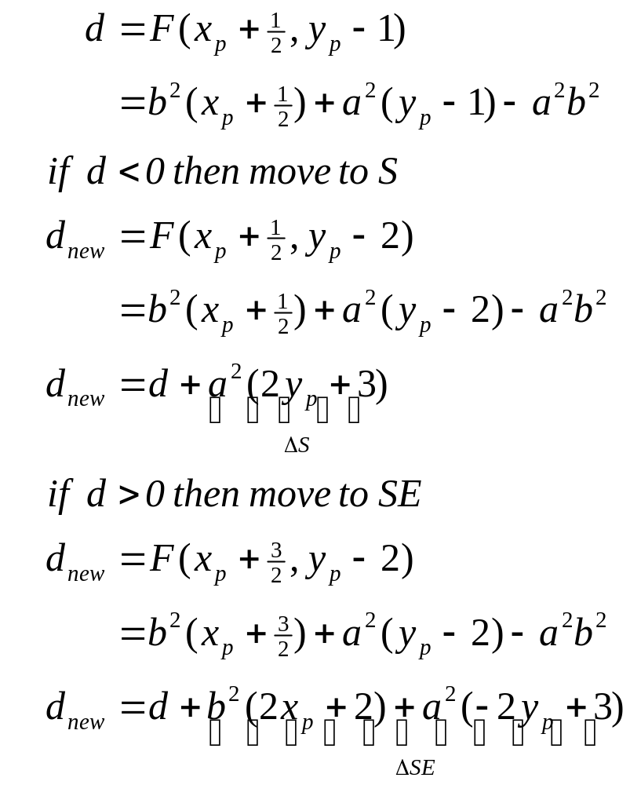



Midpoint Ellipse Algorithm
In region 2
Previous
Current
Next
x_{p}
x_{p}+1
x_{p}+2
P=(x_{p}, y_{p})
y_{p}
y_{p} – 1
S
M
SE
y_{p} – 2
M_{S}
M_{SE}

Slide 17
Self Study
Pseudo code for midpoint ellipse algorithm

